Slide 1
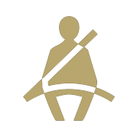
Statewide Safety Belt Use Rates
% Safety Belt Use
For more information, contact Katie Womack, kwomack@tamu.edu.
1

Slide 2
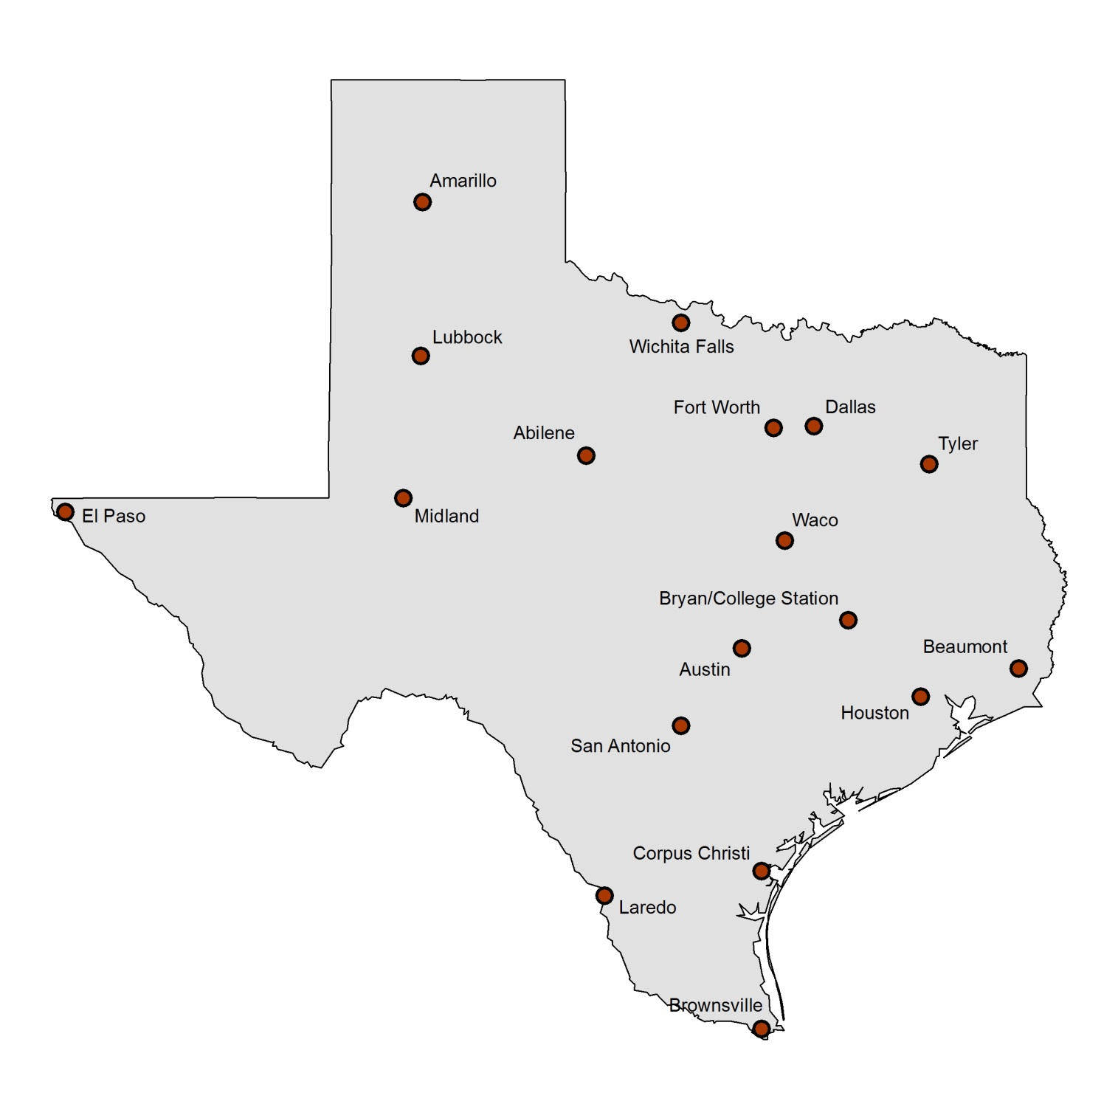
Texas 2021 Safety Belt Use by City
Use is for driver and front seat outboard passenger. Total sample size = 26,047 occupants in 21,600 vehicles (1,200 per city). Average estimate across cities of total restraint use is 88.3%. Drivers were seat belted at a rate of 88.2% and passengers at a rate of 88.8%.
85.8%
89.0%
87.8%
82.4%
83.2%
87.0%
87.4%
92.3%
89.9%
87.4%
90.7%
82.8%
93.2%
85.6%
88.9%
89.4%
93.9%
92.3%
For more information, contact Katie Womack, kwomack@tamu.edu.
2

Slide 3
Texas 2021 Nighttime Safety Belt Use by City
Use is for driver and front seat outboard passenger combined. Total sample size = 21,449 occupants. Average estimate across cities of total nighttime restraint use is 78.2%. Drivers were seat belted at a rate of 77.8% and passengers at a rate of 79.8%.
76.1%
81.4%
75.6%
72.4%
75.0%
81.1%
78.2%
83.1%
76.9%
80.7%
86.0%
86.2%
62.4%
69.6%
77.9%
81.6%
85.6%
87.0%
For more information, contact Katie Womack, kwomack@tamu.edu.
3

Slide 4
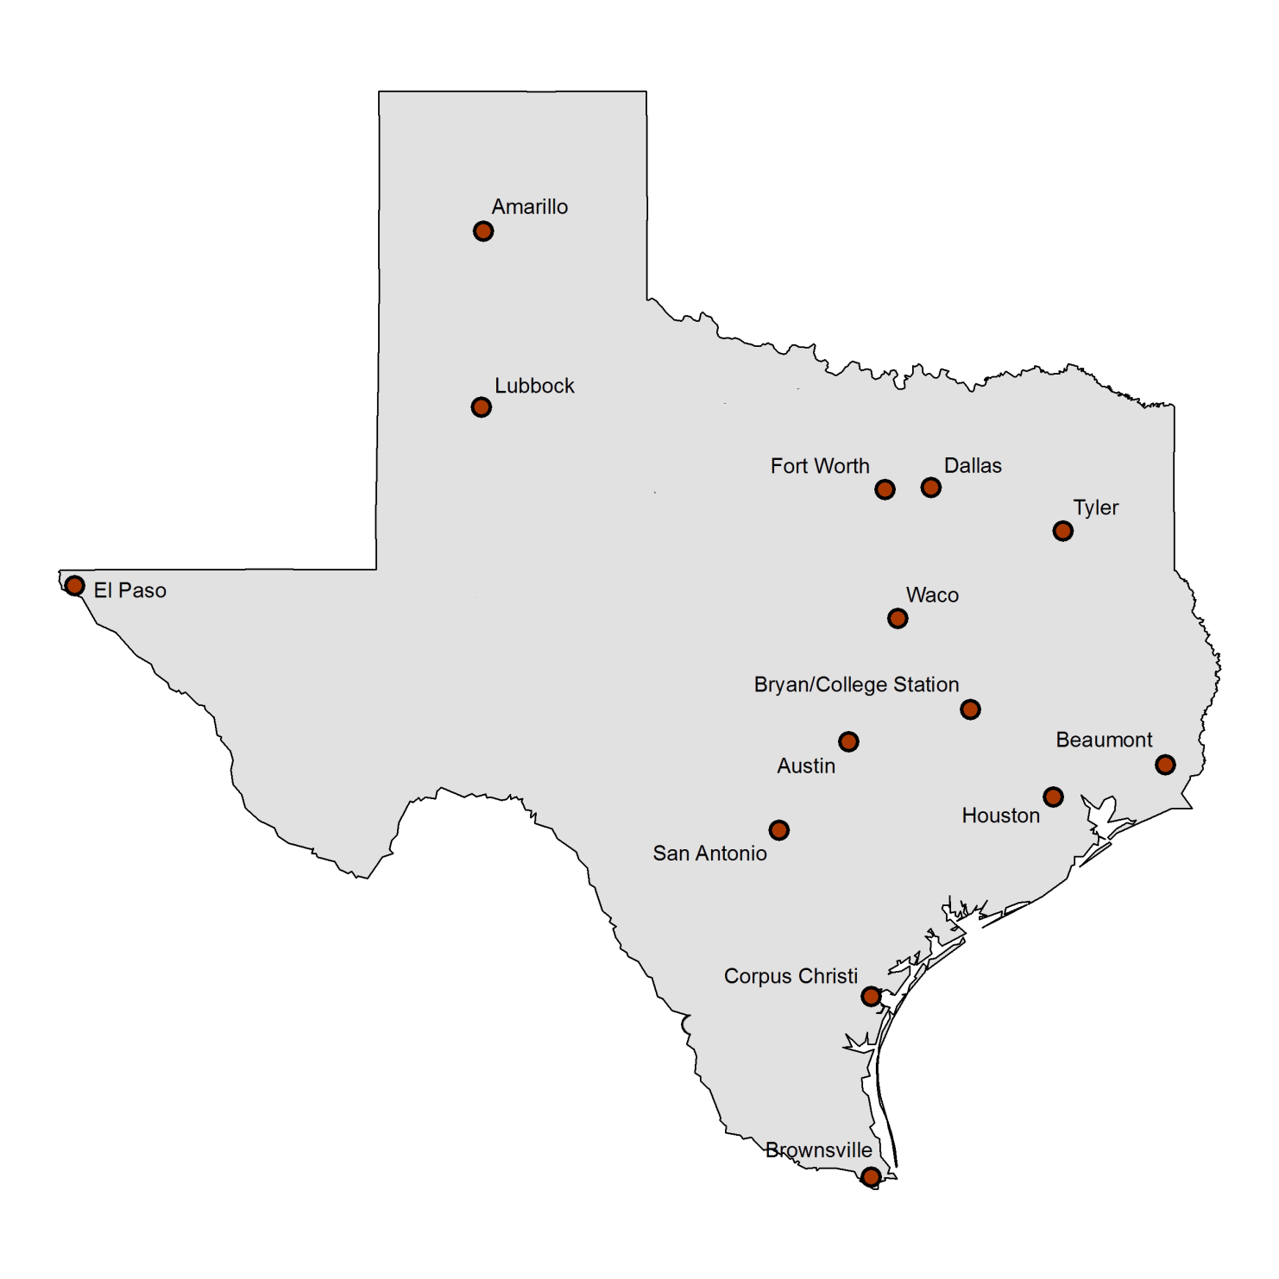
2021 Child Restraint Use in 14 Texas Cities
Surveys conducted at child care centers and shopping center entry points. Children estimated as 4 years old and younger included in the sample. Total sample size = 12,797. Average estimate across cities of total restraint use is 86.8%.
86.8%
83.0%
87.3%
84.3%
88.2%
87.6%
83.7%
92.2%
91.9%
84.5%
87.3%
89.0%
87.1%
83.3%
For more information, contact Katie Womack, kwomack@tamu.edu.
4

