Slide 1
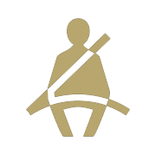
Statewide 2019 Safety Belt Use Rates
% Safety Belt Use
For more information, contact Katie Womack, kwomack@tamu.edu.
1

Slide 2
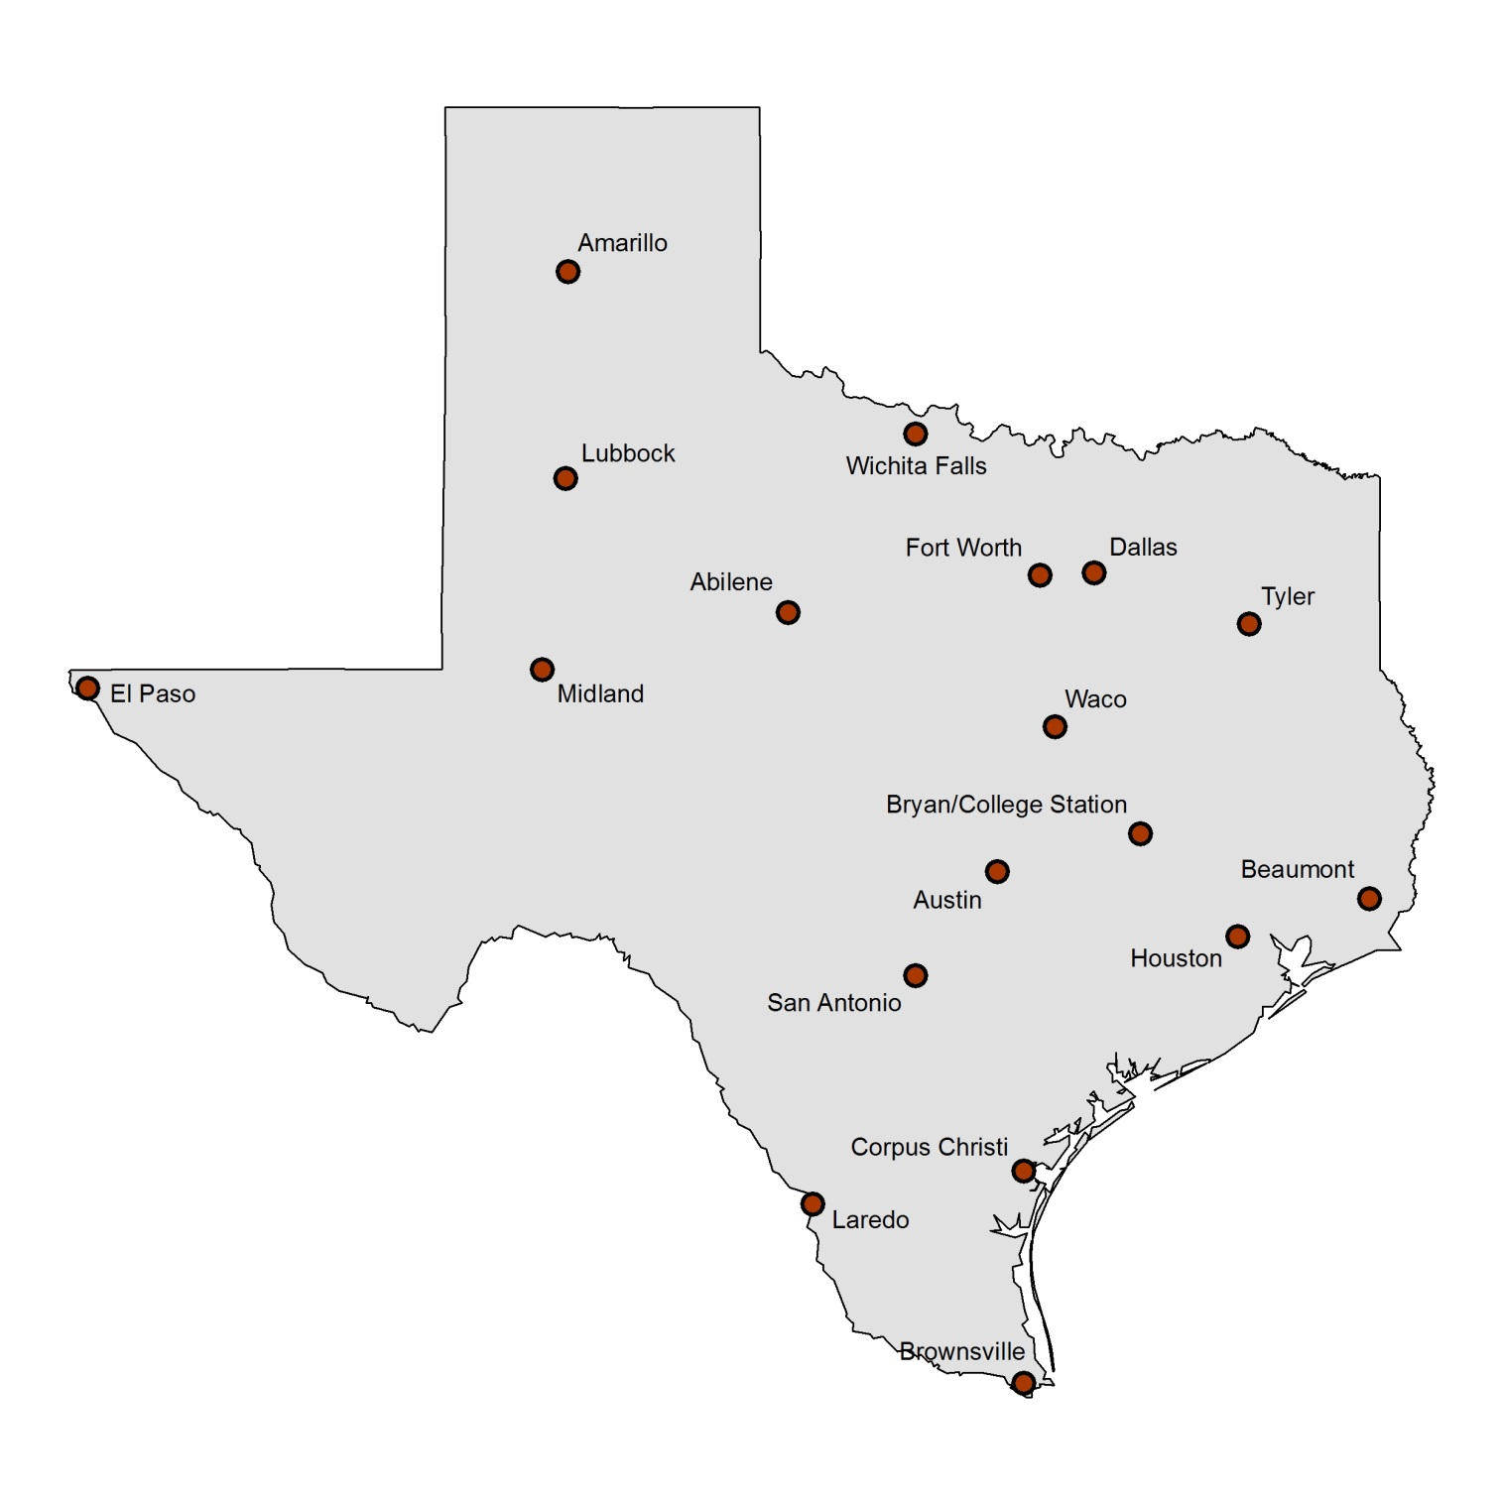
Texas 2019 Safety Belt Use by City
Use is for driver and front seat outboard passenger. Total sample size = 26,113 occupants in 21,600 vehicles (1,200 per city). Average estimate across cities of total restraint use is 89.0%. Drivers were seat belted at a rate of 89.2% and passengers at a rate of 87.6%.
89.9%
89.7%
92.3%
85.7%
84.8%
87.4%
90.4%
91.0%
87.2%
88.7%
90.0%
85.2%
92.8%
87.9%
88.9%
89.1%
88.0%
91.9%
For more information, contact Katie Womack, kwomack@tamu.edu.
2

Slide 3
Texas 2019 Nighttime Safety Belt Use by City
Use is for driver and front seat outboard passenger combined. Total sample size = 22,763 occupants. Average estimate across cities of total nighttime restraint use is 84.6%. Drivers were seat belted at a rate of 84.4% and passengers at a rate of 85.5%.
85.3%
87.8%
84.2%
85.4%
82.4%
86.4%
83.6%
85.6%
85.2%
84.7%
86.7%
88.9%
79.2%
80.5%
85.2%
82.5%
83.3%
86.5%
For more information, contact Katie Womack, kwomack@tamu.edu.
3

Slide 4
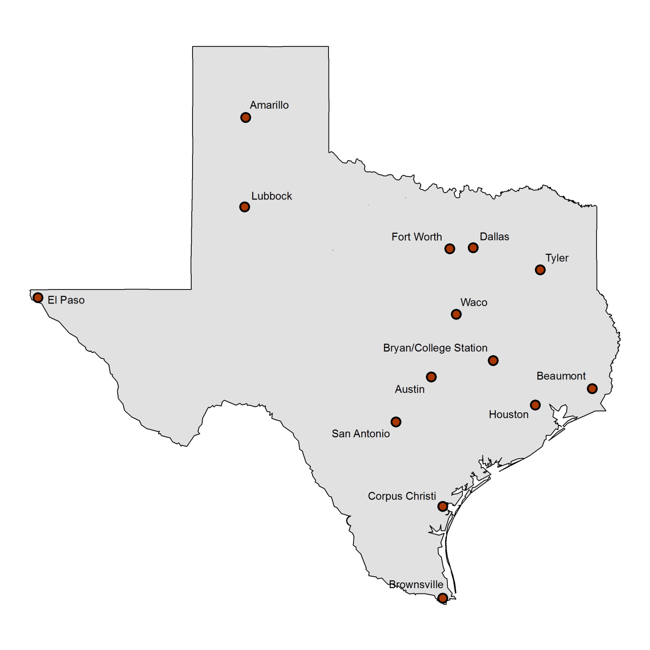
2019 Child Restraint Use in 14 Texas Cities
Surveys conducted at child care centers and shopping center entry points. Children estimated as 4 years old and younger included in the sample. Total sample size = 13,853. Average estimate across cities of total restraint use is 87.5%.
88.6%
88.4%
87.4%
83.2%
91.6%
90.1%
86.6%
90.7%
93.6%
82.7%
89.5%
89.4%
83.4%
78.9%
For more information, contact Katie Womack, kwomack@tamu.edu.
4

Slide 5
2019 School-Age Child Restraint Use in 18 Texas Cities
Surveys conducted in or near school zones in four quadrants in each city, with a quota sample of a minimum of 500 vehicles/city. Total sample size = 11,581. Children estimated as 5-16 years old included in the sample. Average percent use across all cities = 56.9%.
60.8%
57.1%
75.6%
60.8%
52.4%
62.6%
72.5%
77.0%
70.2%
44.1%
72.1%
42.0%
47.8%
45.3%
50.6%
44.0%
48.1%
44.5%
For more information, contact Katie Womack, kwomack@tamu.edu.
5

