Slide 1
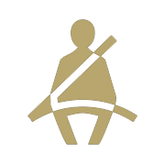
Statewide 2018 Safety Belt Use Rates
% Safety Belt Use
For more information, contact Katie Womack, kwomack@tamu.edu.
1

Slide 2
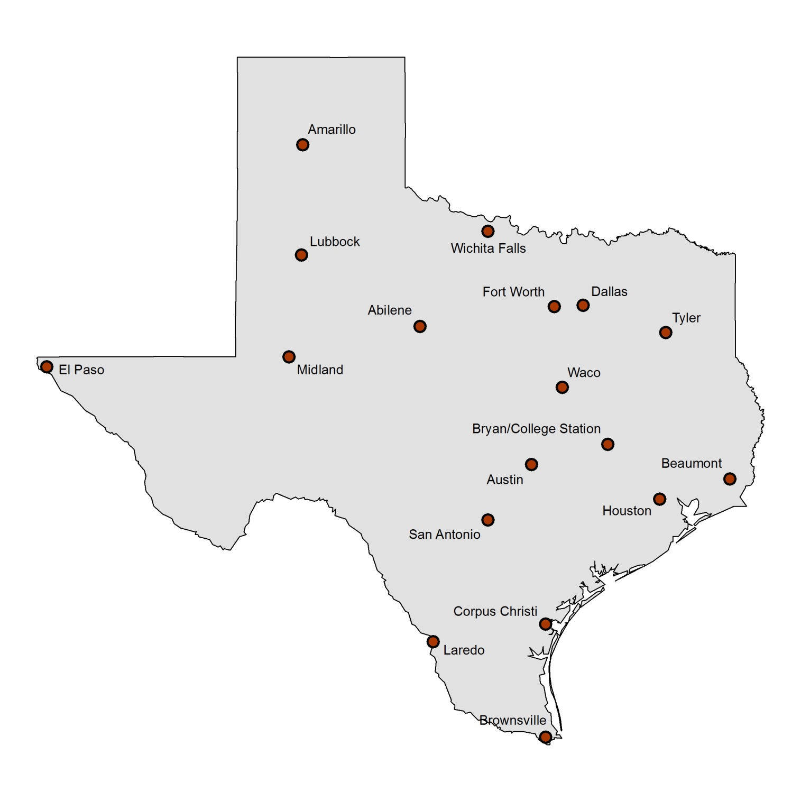
Texas 2018 Safety Belt Use by City
Use is for driver and front seat outboard passenger. Total sample size = 26,232 occupants in 21,600 vehicles (1,200 per city). Average estimate across cities of total restraint use is 89.7%. Drivers were seat belted at a rate of 90.0% and passengers at a rate of 88.1%.
91.2%
89.0%
92.2%
86.1%
86.6%
87.0%
91.8%
93.2%
90.8%
89.5%
89.6%
85.2%
93.9%
88.2%
90.8%
90.2%
88.9%
89.7%
For more information, contact Katie Womack, kwomack@tamu.edu.
2

Slide 3
Texas 2018 Nighttime Safety Belt Use by City
Use is for driver and front seat outboard passenger combined. Total sample size = 23,192 occupants. Average estimate across cities of total nighttime restraint use is 85.8%. Drivers were seat belted at a rate of 85.4% and passengers at a rate of 87.1%.
82.4%
85.5%
84.2%
84.0%
80.8%
83.8%
87.5%
88.9%
87.7%
86.3%
92.6%
90.6%
79.0%
84.4%
89.5%
82.7%
84.7%
87.2%
For more information, contact Katie Womack, kwomack@tamu.edu.
3

Slide 4
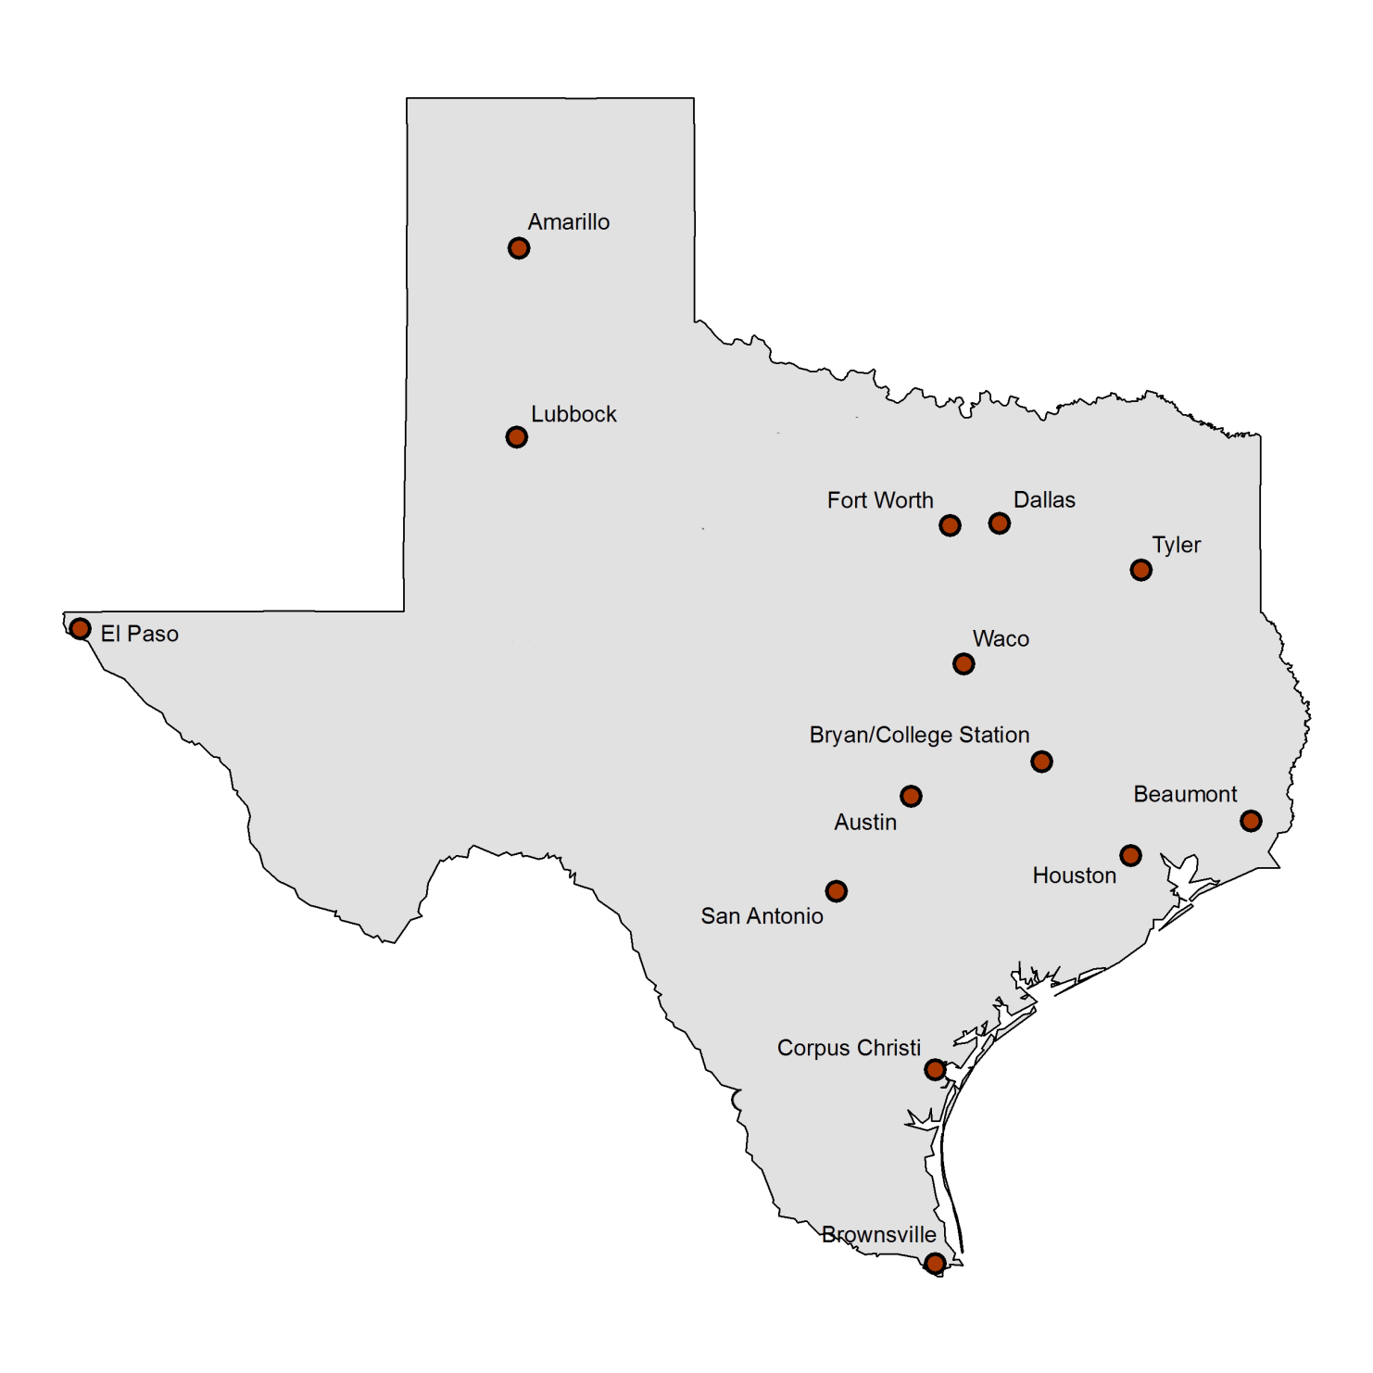
2018 Child Restraint Use in 14 Texas Cities
Surveys conducted at child care centers and shopping center entry points. Children estimated as 4 years old and younger included in the sample. Total sample size = 13,973. Average estimate across cities of total restraint use is 88.4%.
87.1%
92.7%
88.0%
89.8%
95.3%
92.4%
86.8%
91.9%
93.9%
82.6%
86.8%
86.0%
83.7%
76.5%
For more information, contact Katie Womack, kwomack@tamu.edu.
4

Slide 5
2018 School-Age Child Restraint Use in 18 Texas Cities
Surveys conducted in or near school zones in four quadrants in each city, with a quota sample of a minimum of 500 vehicles/city. Total 2018 sample size = 11,844. Children estimated as 5-16 years old included in the sample. Average percent use across all cities = 58.9%.
62.4%
58.3%
78.3%
58.8%
62.0%
65.2%
73.8%
73.0%
68.1%
44.4%
67.5%
47.4%
53.9%
48.8%
48.3%
48.8%
48.9%
55.8%
For more information, contact Katie Womack, kwomack@tamu.edu.
5

Slide 6
Statewide Motorcycle Helmet Use Rates
% Helmet Use
For more information, contact Katie Womack, kwomack@tamu.edu.
6

